Slide 1
Charting the Stars
CSC 335 Final Project By:
Joey McMaster
Nicholas Fiegel
Matt Theisen
Jackson

Slide 2
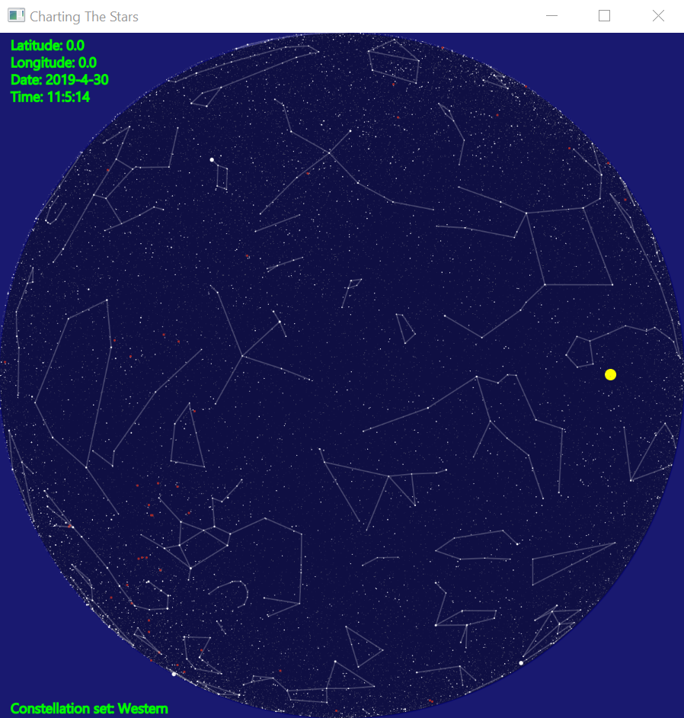
The end product at a glance:
Starting screen features 5 clickable areas:
The four corners that are not covered by the sky projection are clickable. Clicking one of them moves the projection view point up that direction.
Clicking the projection brings up a settings menu to customize the view. By default, everything is displayed.
The perspective of the projection is north being the top of the screen and west being the right side of the screen.

Slide 3
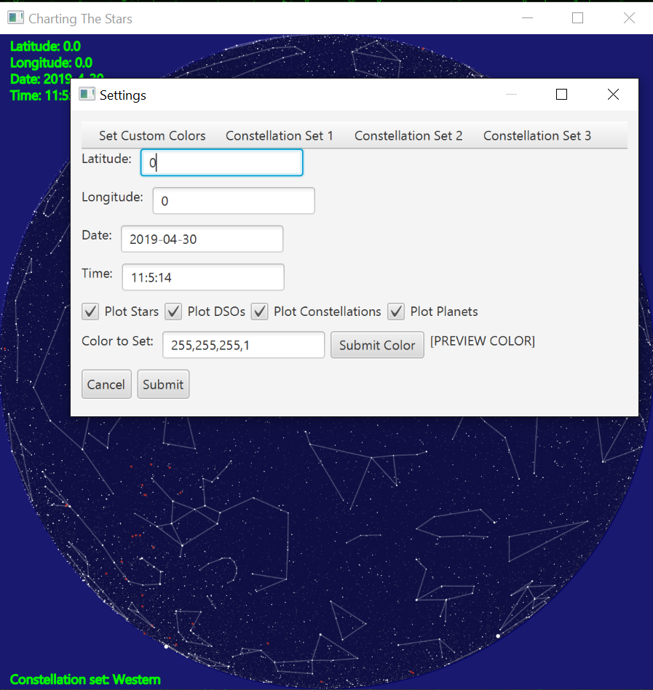
The settings screen:
Clicking the black circle with night sky shows the settings menu.
It allows the user to input a latitude, longitude, date and time. These are then used to plot the stars.
The user can also use the check boxes to only display certain things in the sky. The user can also choose what set of constellations that are displayed and the color and opacity of various UI elements.
Default values for the date is the current day.
Default value for the time is the current time.
Rest of default values are as shown in screen shot.

Slide 4
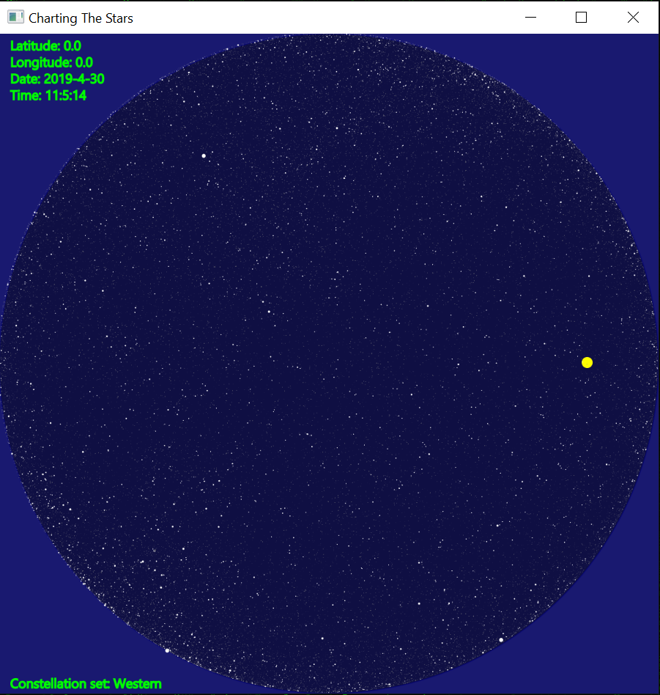
Only the stars with default settings:

Slide 5
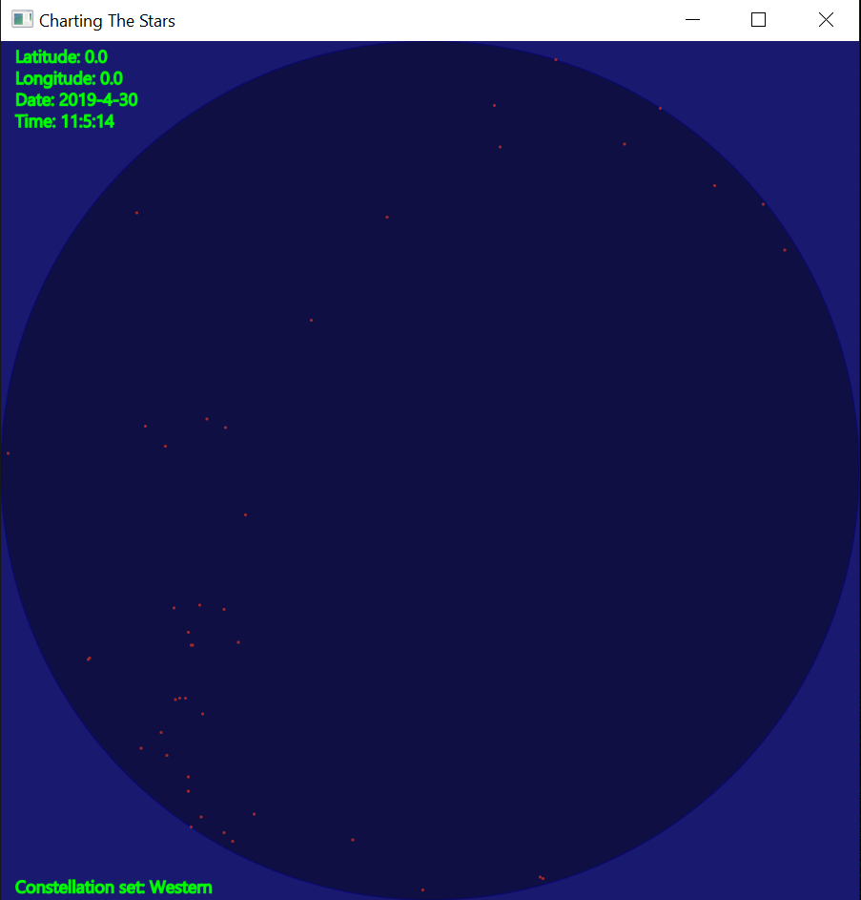
Only the Deep Space Objects (DSO) with default settings

Slide 6
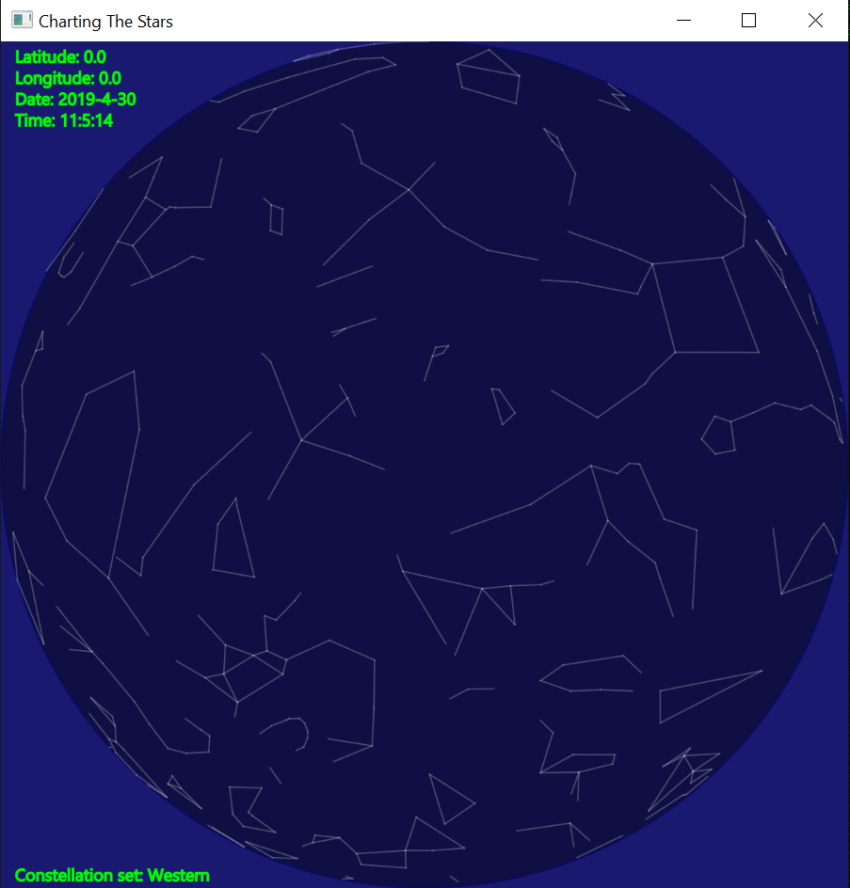
Only the Constellations with default settings:

Slide 7
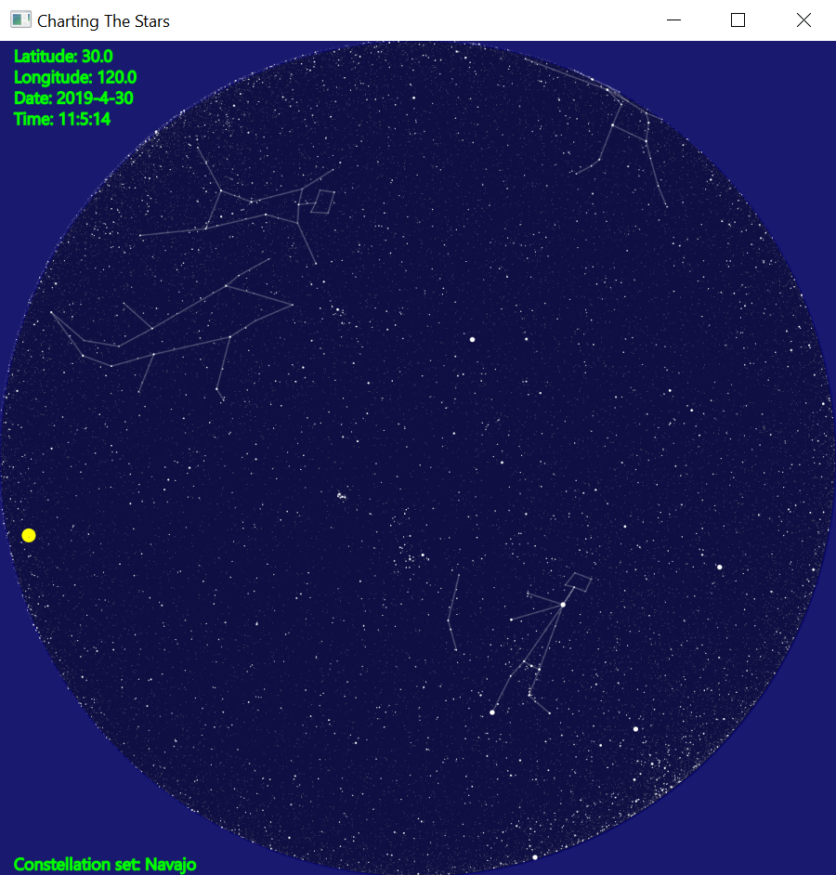
Stars and Constellations with the Navajo set of Constellations selected.

Slide 8
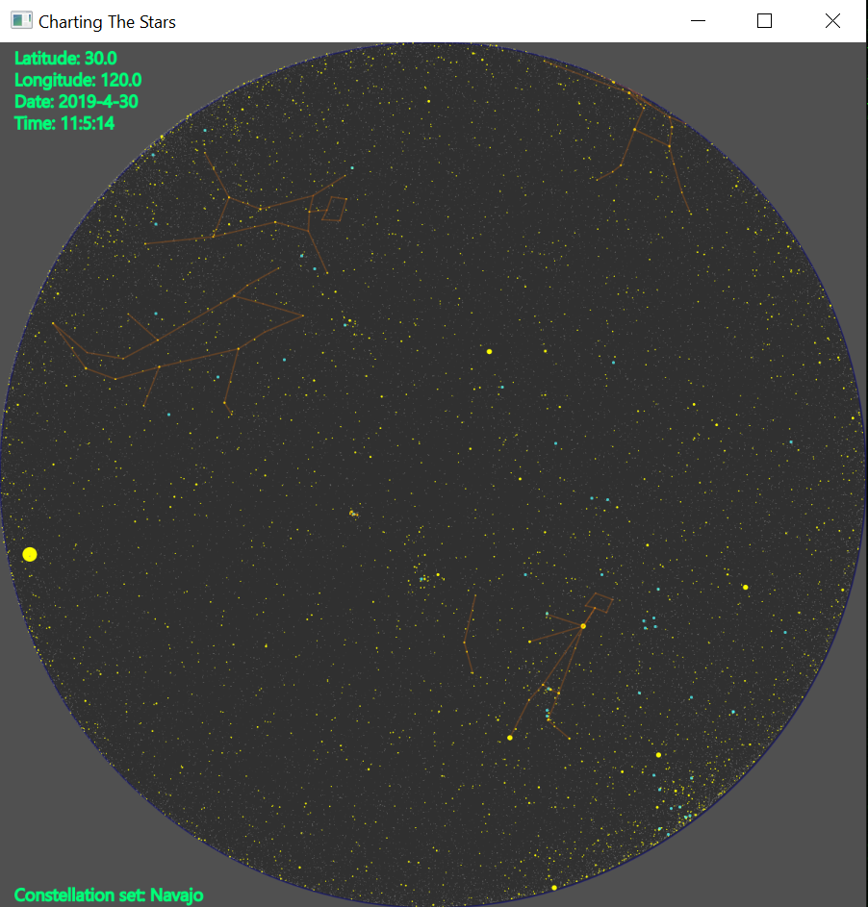
Stars and Constellations with the Navajo set of Constellations selected with most elements having a different colors set from the settings menu.

Slide 9
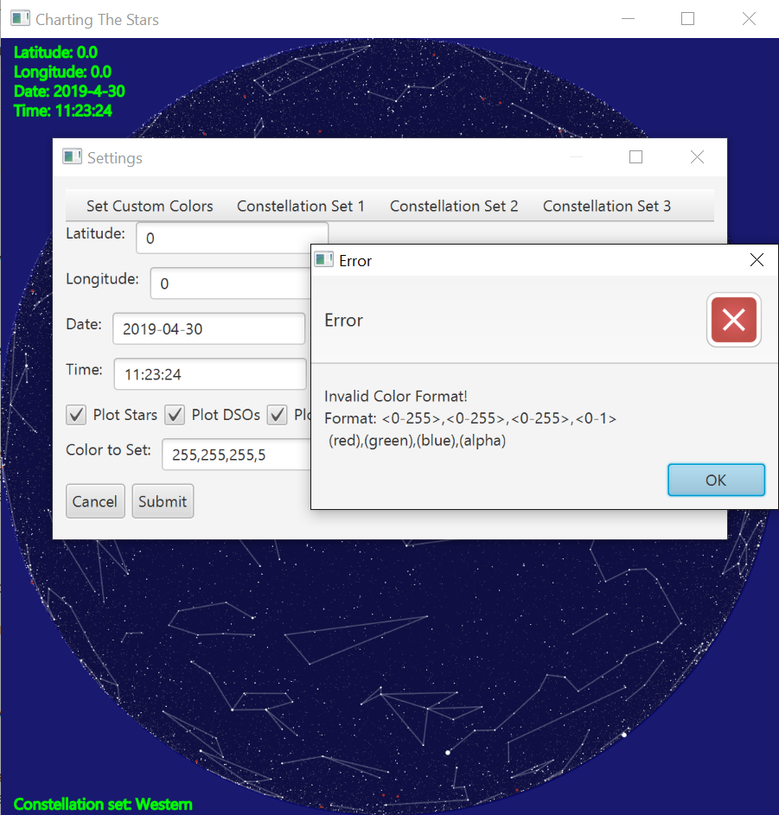
The UI Error checking
In the example, the user tries to set menu elements color to something invalid (set a alpha value above 1). The GUI checks for these errors, if one is found, cancels the operation then opens an alert window with a relevant error message and how to correct it.

Slide 10
Program class layout
Model classes:
CTS_SpaceObject.java – Used a base class for various model objects. Adds a common set of getter and setters to simplify code else where.
CTS_Star.java – Adds a few extra fields and getters for objects that are stars. Extends CTS_SpaceObject.
CTS_Model.java – Acts as the main model class. Loads files from disk and reads them into the various objects. Holds collections of those objects.
CTS_DeepSkyObject.java – Adds a magnitude field for displaying. Extends CTS_SpaceObject.
CTS_Constellation.java – Houses the various data structures needed to denote a full constellation that can be displayed.
CTS_Planet.java – Houes the data that represents a planet.
Controller classes:
CTS_Controller.java – used to modify various model classes. Calculates things that are needed in the GUI.
View classes:
ChartingTheStars.java – used to boot the program
CTS_GUI_Dialoguebox.java – used to set a few settings related to the settings menu.
CTS_GUI.java – houses the GUI code and interacts with the user. Tells the controller what to do.
Testing classes:
JUnitTests.java – Used to test various controller and model functions. Verifies calculations.

Slide 11
Design decisions
The first major decision was to use the MVC design pattern. The View interacts with the controller, the controller interacts with the model. When the view asks for an update, the model is set to the view from the controller.
This enabled us better keep track of purpose of the code that was being written.
The second major decision was to use of a class hierarchy in the model to reduce redundancy. The CTS_SpaceObject was used to implement a series of getters and setters of common fields. It also simplified GUI code when it came time to display the objects location setting the type of the input to CTS_SpaceObject. It ended up having 2 sub classes. It also removed boilerplate code from its subclasses.

